Slide 1
Fire Detection System using WSN
Submitted in the partial fulfillment for the award of the degree of
BACHELOR OF ENGINEERING
IN
CSE (IoT)
Submitted by:
YUVRAJ SHARMA
18BCS4508
VANSHITA MANRAL
18BCS4522
Under the Supervision of:
Mr. Nikhil Aggarwal
Department of AIT-CSE
DISCOVER . LEARN . EMPOWER

Slide 2
Outline
Introduction to Project
Problem Formulation
Objectives of the work
Methodology used
Results and Outputs
Conclusion
Future Scope
References

Slide 3
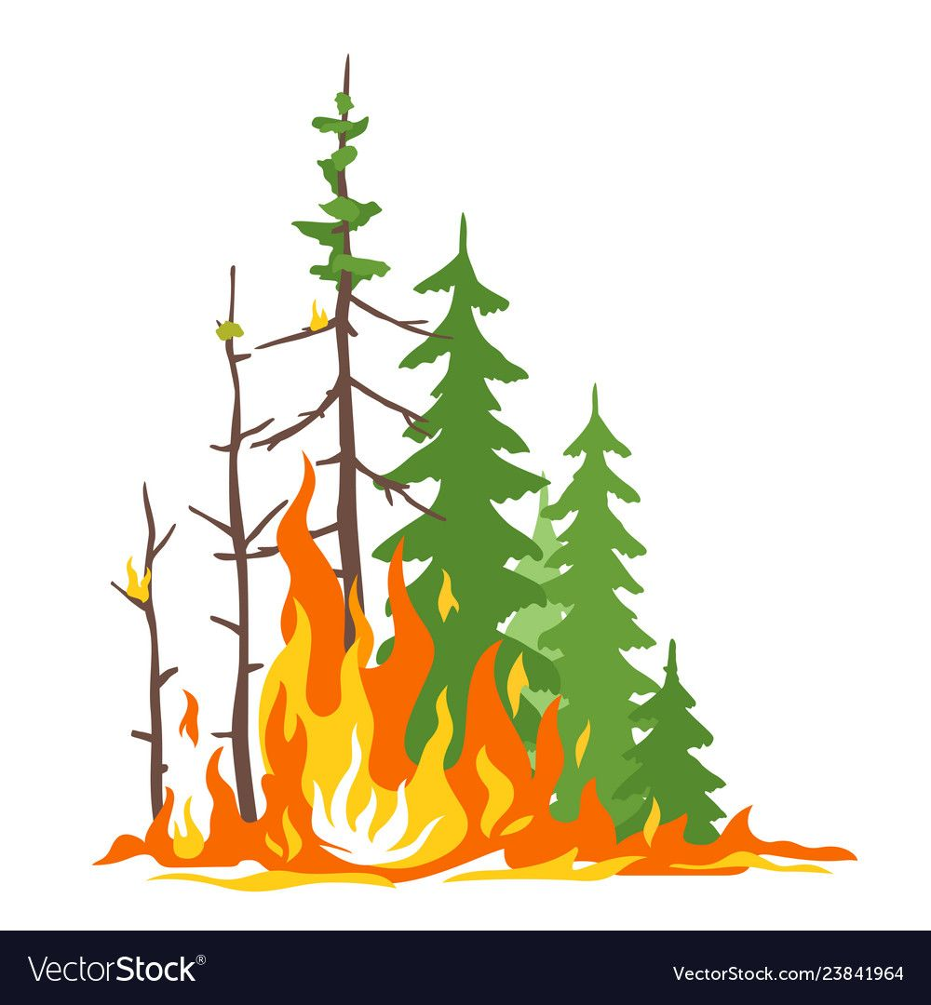
No
More Forest Fire!
No more forest fire now, A System help to detect
Early stages fire with a lot of features to help the
Government.

Slide 4

Introduction to project
This project is all about saving the forests from the natural calamity i.e fire.
In this project we designed a system to detect the fire using the wireless sensor network, moreover detecting it on the early stages considering different factors.

Slide 5
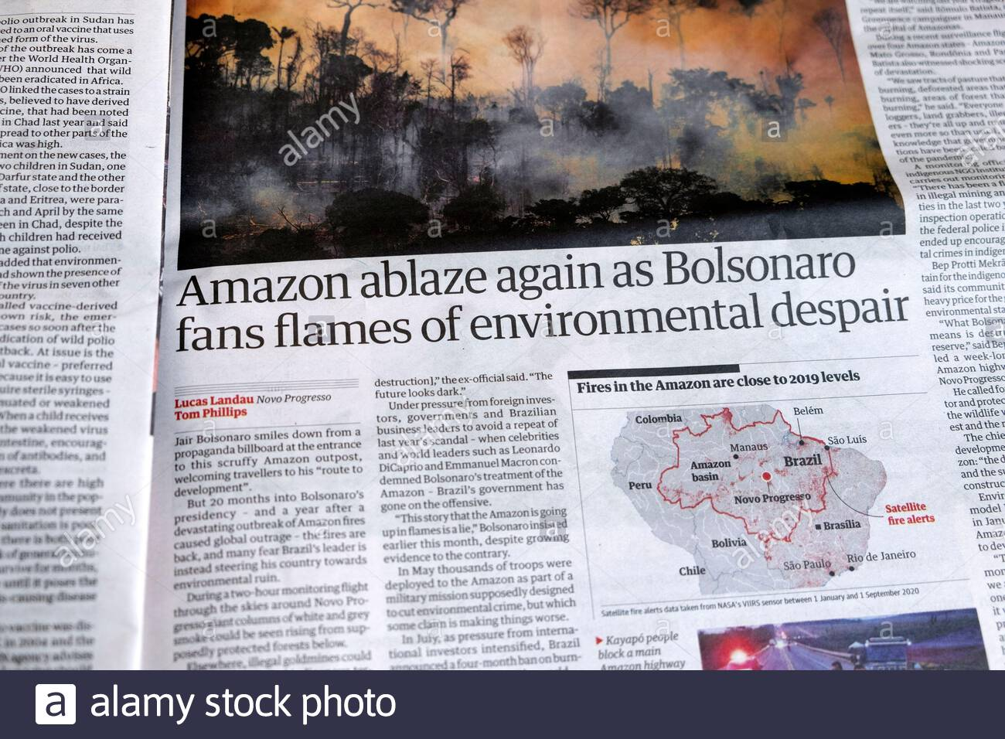
Why this project?
1950, British Columbia, Canada, The Chinchaga fire, 3 million acres.
2020, Australia, 18.6 million acres.
There are more than 72000 wildfire cases in a year over the world.

Slide 6
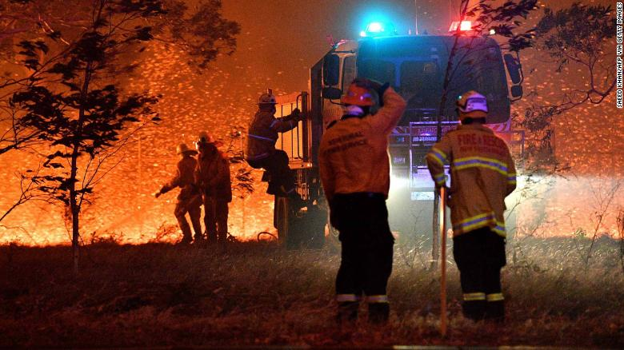
Need for this?
Saving the endangered species, economic properties.
Cheap and can live for more than 4 years without human intervention.
Detection of fire at early stages.
Cost effective solution.

Slide 7

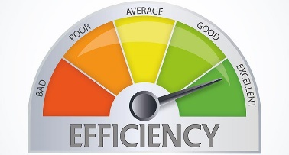
Objectives
Cover
large area
Power efficient
Cheap price

Slide 8
Methodology used
Planning and Requirement Analysis.
Designing the project architecture.
Building the project according to the design.
Testing the project in controlled environment
Deploying the project for further testing.

Slide 9
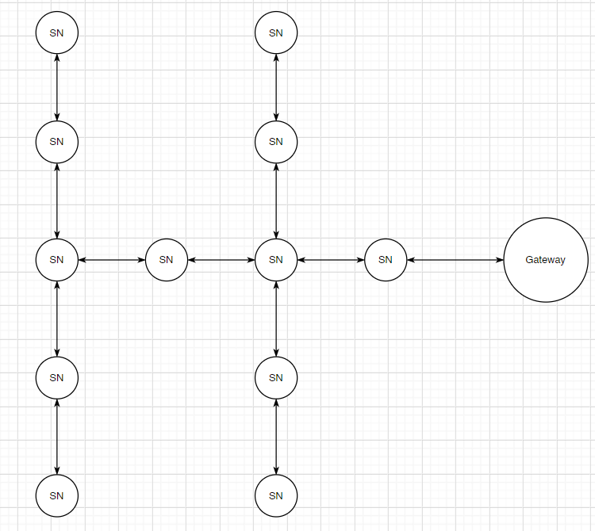
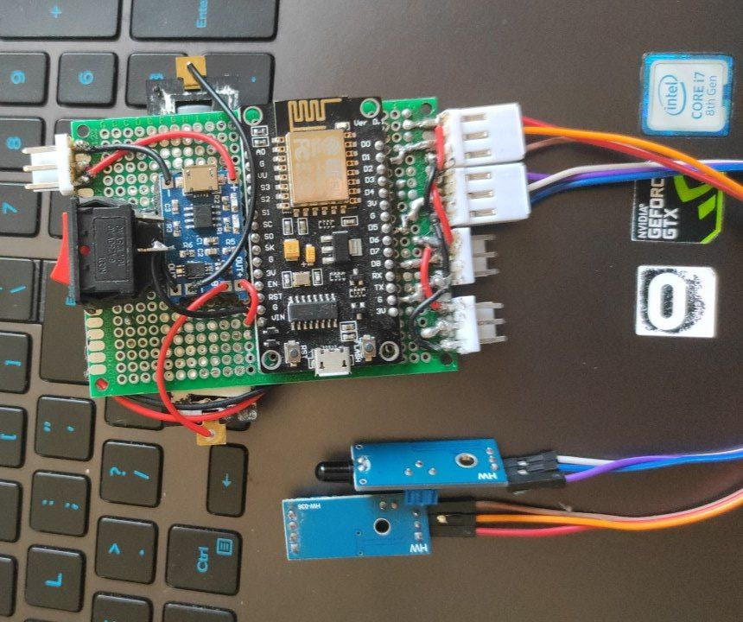
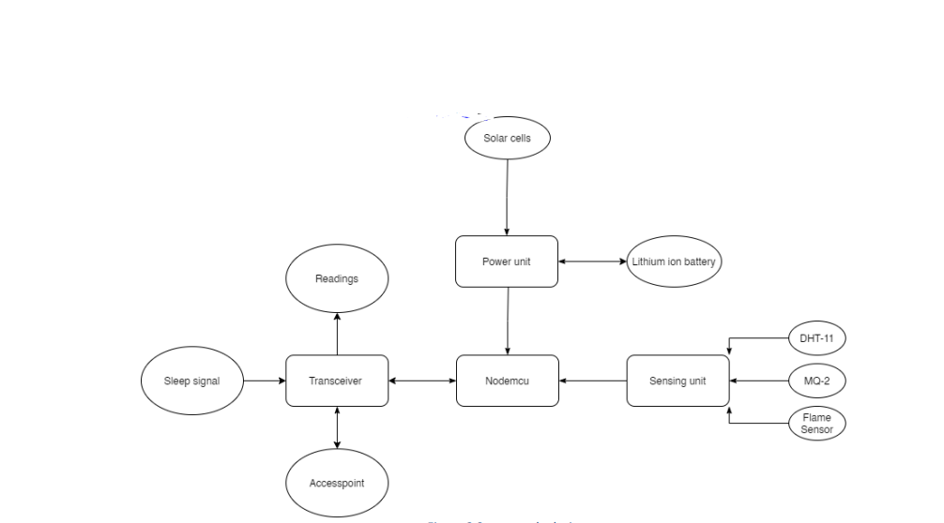
Results & Outputs
1. Designing the WSN

Slide 10
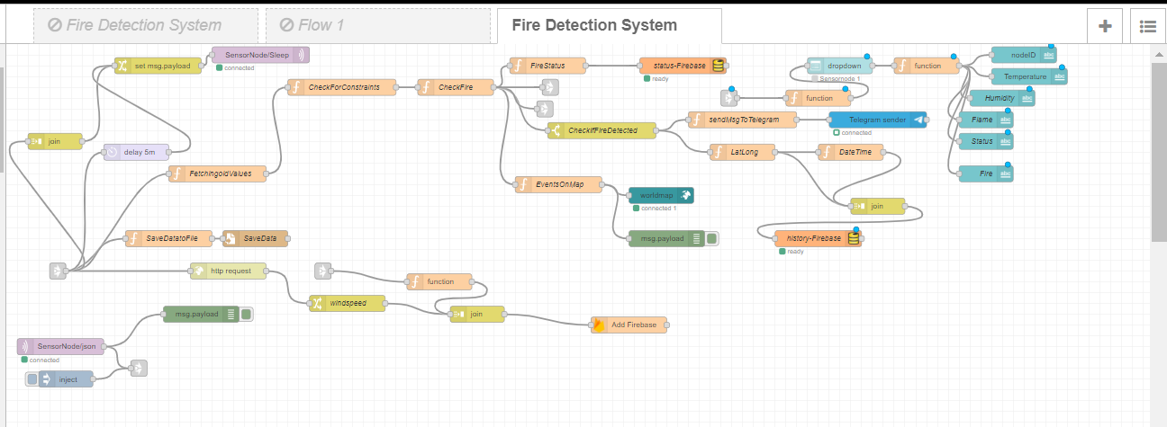
2. Designing the base station

Slide 11
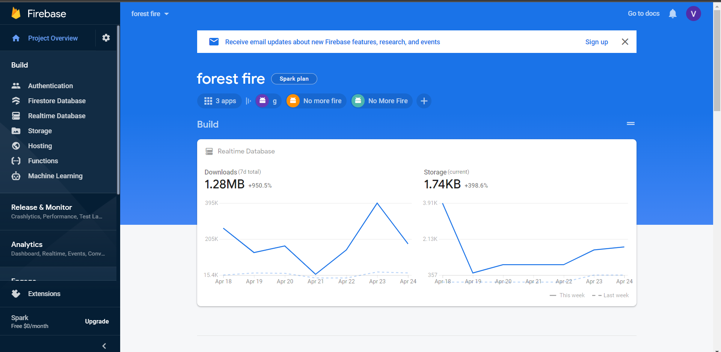
3. Firebase

Slide 12
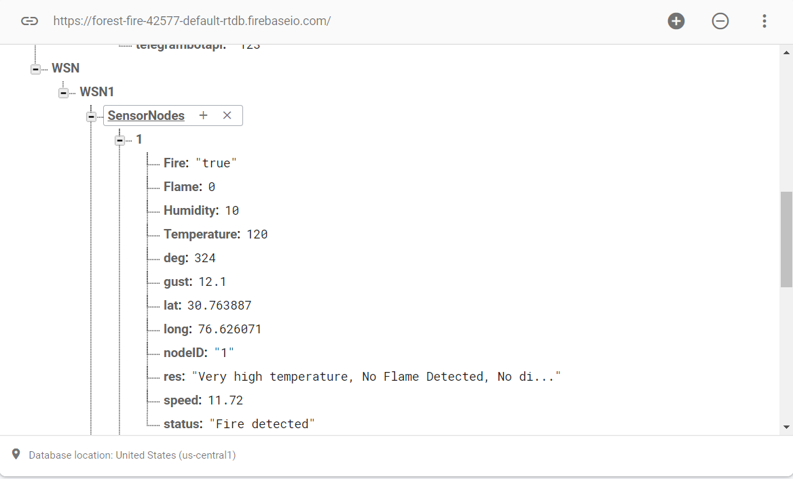
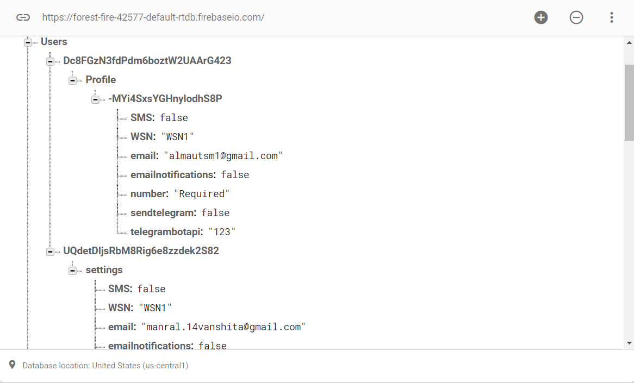

Slide 13
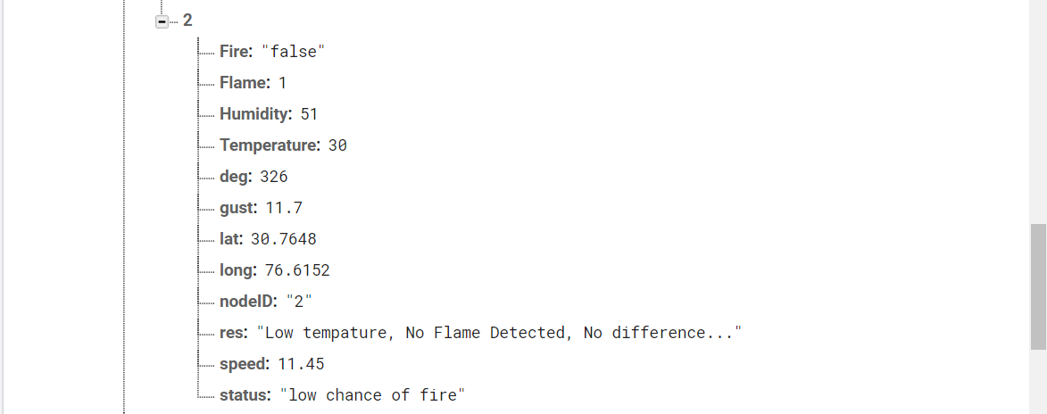
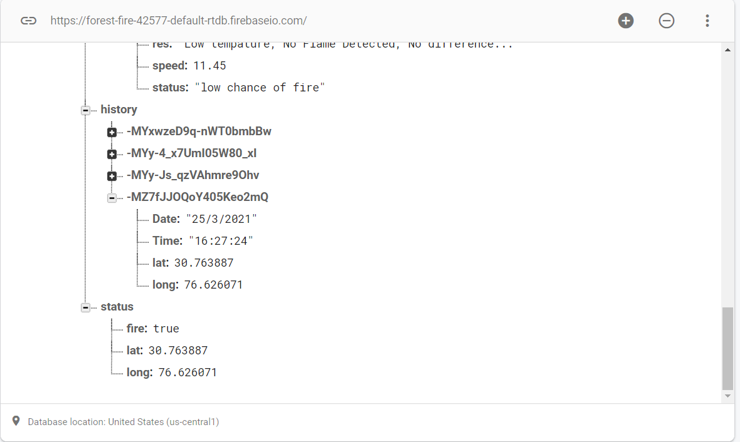

Slide 14
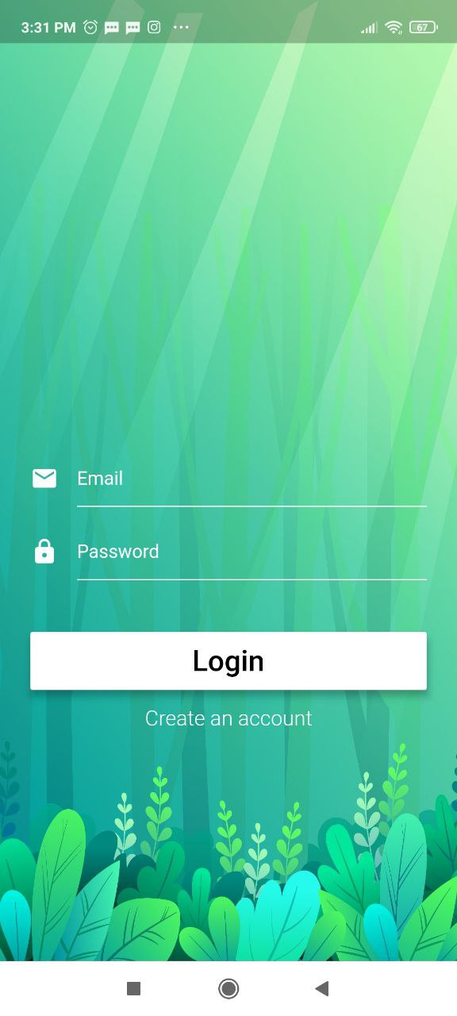
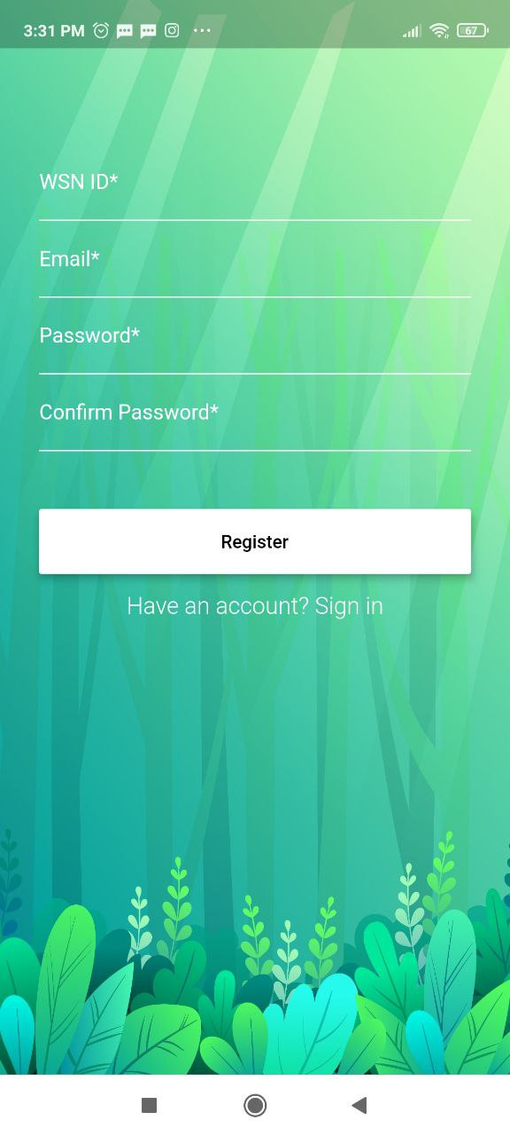
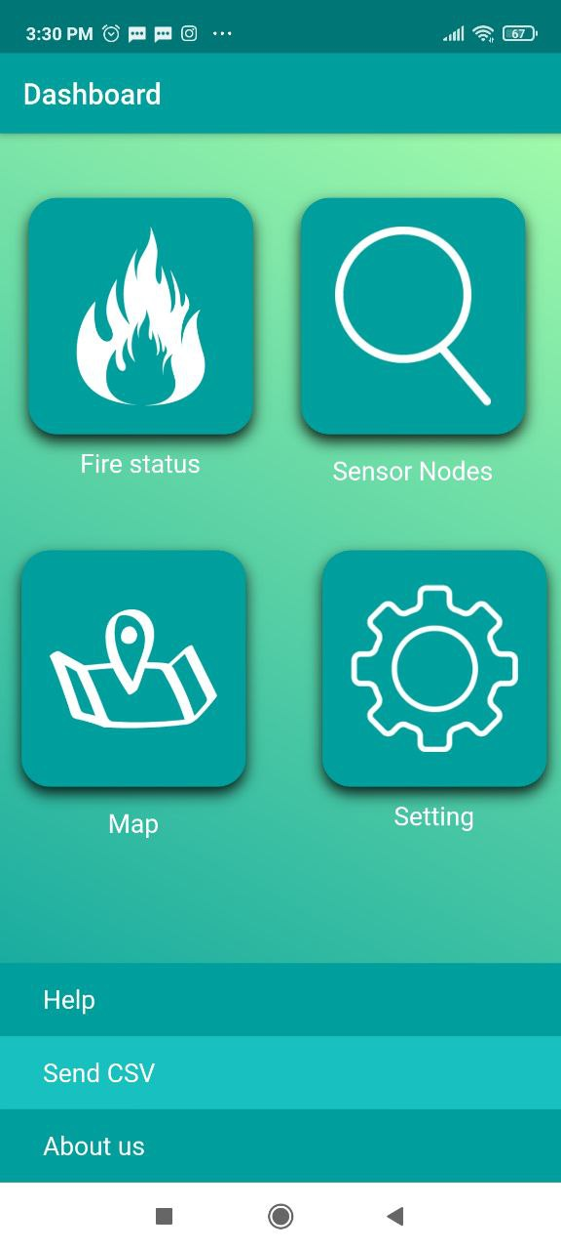
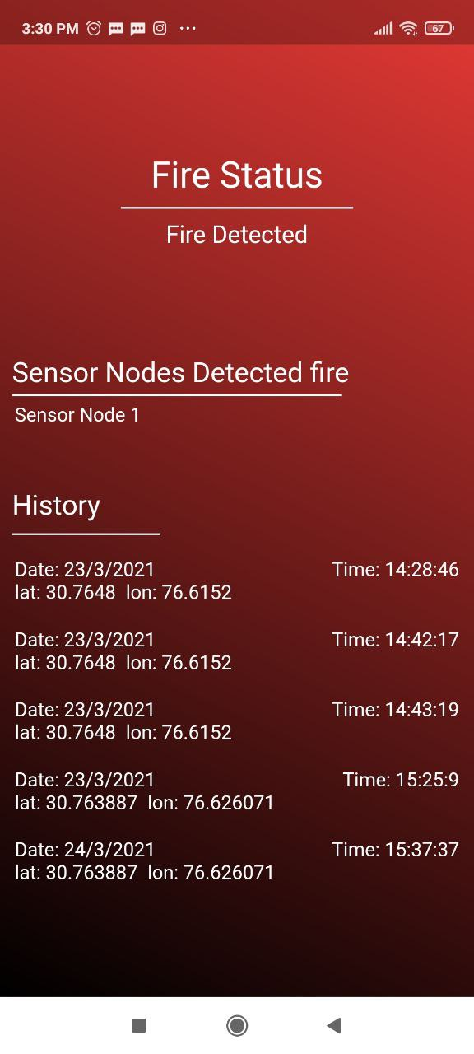
4. Designing the interfaces.
Application

Slide 15
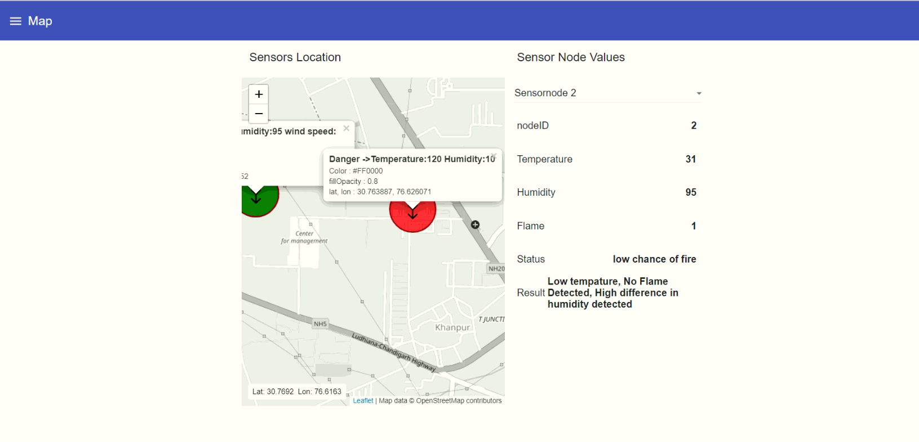
Node-red Dashboard

Slide 16
Conclusion
Detected fire using multiple sensor nodes.
It shows the sensor node location in map.
Shows the direction where the fire is possible to spread.
It was able to cover large areas.
Power efficient

Slide 17
Future Scope
Making the WSN insulted.
Adding more features into the flutter app to increase the user experience .

Slide 18
References
https://www.hindawi.com/journals/mpe/2018/7612487/
journals.sagepub.com
https://www.hindawi.com/journals/js/2016/8325845/
https://www.sciencedirect.com/science/article/pii/S1877705812032201
https://ieeexplore.ieee.org/document/5138260
https://robu.in/

